Slide 1
Statistics for linguists
2023-12-06
Chi-squared test, loglinear models

Slide 2
From last class
Linear models
Errors and residuals
Sum of squares
ANOVA

Slide 3
For this class
Directed acyclic graphs (introduction)
Chi-squared test
Loglinear model / logistic regression

Slide 4
Packages

Slide 5
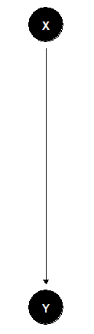
Direct acyclic graph
A directed acyclic graph represents our assumptions about causal direction.
When you use a statistical model you imply assumptions about causation between your variables.
So far, we have just been dealing with very simple causal relations (simple ‘bivariate’ models)
read as ‘X causes Y’

Slide 6
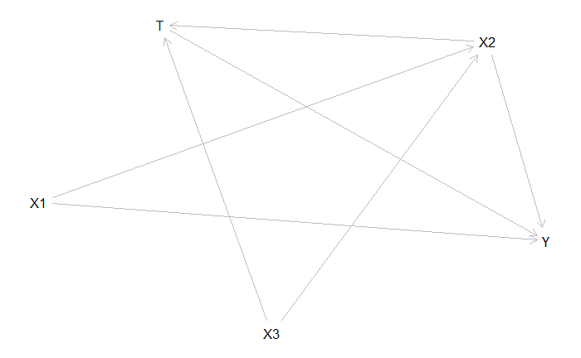
Directed acyclic graph (DAG)
The causal relations can get very complicated though.
DAGs are used for causal inference – if your statistical model is paired with DAG it means you can infer causation from your model, rather than just correlation
Pearl, Judea. 2009. Causality: Models, Reasoning and Inference. Cambridge: Cambridge University Press.

Slide 7
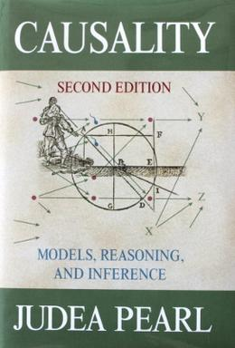

Causal inference & the Causal revolution
Pearl, Judea. 2009. Causality: Models, Reasoning and Inference. Cambridge University Press.
Pearl, Judea (with Dana Mackenzie). The book of Why: The new science of cause and effect. Penguin.

Slide 8
Direct acyclic graph
Linear model / Regression
  X = continuous
  Y = continuous
ANOVA
  X is categorical
  Y is continuous
read as X causes Y

Slide 9
Direct acyclic graph
Linear model / Regression
  X = continuous
  Y = continuous
ANOVA
  X is categorical
  Y is continuous
Chi-squared
  X is categorical
  Y is continuous
Loglinear model / Logistic regression
  X is continuous
  Y is categorical
read as X causes Y

Slide 10
coord_dag <- list(
x = c(X = 2, Y = 2),
y = c(X = 3, Y = 1)
)
our_dag <- ggdag::dagify(Y ~ X,
coords = coord_dag)
ggdag::ggdag(our_dag) + theme_void()
dag <- dagitty("dag {
X1 -> X2
X1 -> Y
X3 -> X2
X2 -> Y
X2 -> T -> Y
X3 -> T
}")
plot( graphLayout( dag ) )

Slide 11
Counts & contingency tables
A lot of statistical information comes from counts (e.g. frequency of words in different texts)
The data are usually presented in a contingency table.
Data from Matthew Dryer (1992)
OV = Object-Verb words order / VO = Verb-Object word order
Postp = positions / Prep = prepositions
H1:postpositions are associated with OV word order and prepositions are associated with VO order
Dryer, Matthew S. 1992. The Greenbergian Word Order Correlations. Languages 68:1, 81-138.

Slide 12
Contingency table (word order associations)
 | OV | VO
Postp | 107 | 12
Prep | 7 | 70
adpos <- matrix(c(107,12,7,70),ncol=2,byrow=TRUE)
rownames(adpos)<-c("PostP","Prep")
colnames(adpos)<-c("OV","VO")
adpos
Dryer, Matthew S. 1992. The Greenbergian Word Order Correlations. Languages 68:1, 81-138.

Slide 13
Counts and probabilities
These are observed frequencies
We now need a model that predicts the expected frequencies
Using these data, what is the probability of a random language from this sample having OV?
Dryer, Matthew S. 1992. The Greenbergian Word Order Correlations. Languages 68:1, 81-138.

Slide 14
Counts and probability
wordorder <- cbind(c(107, 7), c(12, 70))
rownames(wordorder) <- c("Postp", "Prep")
colnames(wordorder) <- c("OV", "VO")
wordorder <- rbind(wordorder, c(114,82))
wordorder <- cbind(wordorder, c(119,77,196))
rownames(wordorder) <- c("PostP", "Prep", "Column Total")
colnames(wordorder) <- c("OV", "VO", "Row total")
wordorder

Slide 15
Expected Frequency
Raw total (Postp = 119, Prep = 77)
Column total (OV = 114, VO = 82)
Grand total = 196
Expected = (Raw total * Column total) / Grand total
Dryer, Matthew S. 1992. The Greenbergian Word Order Correlations. Languages 68:1, 81-138.

Slide 16
Expected frequency
The expected frequency refers to what the values would be if VO/OV and Postp/Prep were independent.
 | OV | VO
Postp | (114*119)/196 | (82*119)/196
Prep | (114*77)/196 | (82*77)/196
E <- cbind(c((114*119)/196, (114*77)/196),
c(82*119/196,(82*77)/196))
rownames(E) <- c("Postp", "Prep")
colnames(E) <- c("OV", "VO")
E

Slide 17
Expected frequency
What we’ve done is created a hypothetical “null distribution” against which we can measure how surprising our actual data are.
 | OV | VO
Postp | 69.21429 | 49.78571
Prep | 44.78571 | 32.21429

Slide 18
Expected frequency vs. real frequencies
What we’ve done is created a hypothetical “null distribution” against which we can measure how surprising our actual data are.
 | OV | VO
Postp | 69.21429 | 49.78571
Prep | 44.78571 | 32.21429
 | OV | VO
Postp | 107 | 12
Prep | 7 | 70

Slide 19
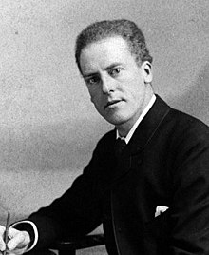
Chi-squared test
The classical way of doing this is Karl Pearson’s chi-squared test.
https://upload.wikimedia.org/wikipedia/commons/2/21/Karl_Pearson_2.jpg

Slide 20
E <- cbind(c((114*119)/196, (114*77)/196),
c(82*119/196,(82*77)/196))
rownames(E) <- c("Postp", "Prep")
colnames(E) <- c("OV", "VO")
E
E.df <- melt(E)
colnames(E.df)<-c("Adposition", "Verb.Object", "Expected.Frequency")
E.df$Observed.Frequency <- c(107,7,12,70)
E.df
Putting expected and observed data in the same data set
E.df$oe <- ((E.df$Observed.Frequency - E.df$Expected.Frequency)^2) / E.df$Expected.Frequency
sum(E.df$oe)

Slide 21
Chi-squared test and p values
Is this number big?
What is the critical value of the chi-squared test?
To calculate this, we need the degrees of freedom and the cut off area you want.
R = number of rows
C = number of columns

Slide 22
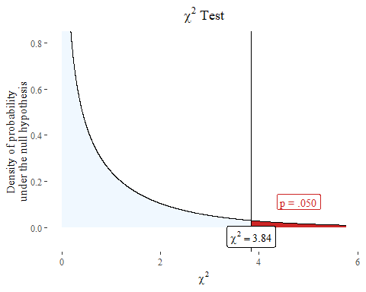
Chi-squared test and p-value
We have another hypothetical distribution based like the t distribution.

Slide 23
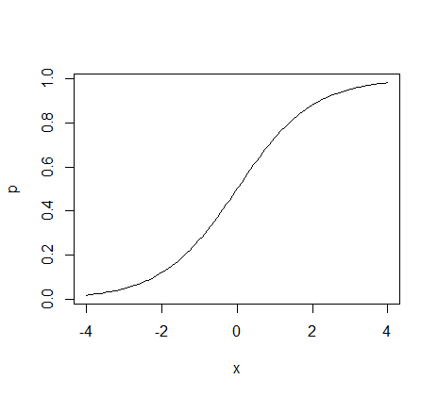
Logistic regression

Slide 24
Logistic regression
The logistic regression is a method for modelling binary data.
The basic ideas can be extended to non-binary data as long as they are organized into levels.
It is typically used when the dependent variable is binary and there is an interest in knowing how a change in x effects the probability that something is y.

Slide 25
Logistic regression
Psycholingustic experiments where subjects have to give yes or no answers.
Various uses in natural language processing
Predict the risk of developing a specific disease
Predict the probability that someone will vote for a particular political party.
...

Slide 26
Logistic regression
A logistic regression or logit model can be represented with the following equations ....

Slide 27
Logistic regression
A logistic regression or logit model can be represented with the following equations ....
The intercept plus the coefficient times x (plus error etc.) is equal to y output from a logit function

Slide 28
Logistic regression
A logistic regression or logit model can be represented with the following equations ....
The logit function is the log of a probability divided by 1 minus that probability – the “log odds”

Slide 29
Logistic regression
A logistic regression or logit model can be represented with the following equations ....
So to get the probability that y is 1 given x, you divide the loglinear variables by an equation that reverses the logit function.

Slide 30
Logistic regression
A logistic regression or logit model can be represented with the following equations ....
Just algebra
So to get the probability that y is 1 given x, you divide the loglinear variables by an equation that reverses the logit function.

Slide 31
Bernouilli distribution
A Bernouilli distribution is a discrete distribution with two possible outcomes.
We want to account for the distribution of y.
You can model it with rbinom()

Slide 32

Bernouilli distribution
A Bernouilli distribution is a discrete distribution with two possible outcomes.
We want to account for the distribution of y.
You can model it with rbinom()
By Niklaus Bernoulli (1662-1716) - [2] [3], Public Domain, https://commons.wikimedia.org/w/index.php?curid=266673

Slide 33
Bernouilli distribution
A Bernouilli distribution is a discrete distribution with two possible outcomes.
We want to account for the distribution of y.
You can model it with rbinom()
‘The probability of y being 1 is p and the probability of y being 0 is p – 1’

Slide 34
Bernouilli distribution
A logistic regression or logit model can be represented with the following equations ....
bernouilli_data <- rbinom(20, 1, 0.5)
print(bernouilli_data)
## [1] 1 1 1 0 0 1 0 0 1 0 0 1 0 0 0 1 0 0 0 1

